Slide 1
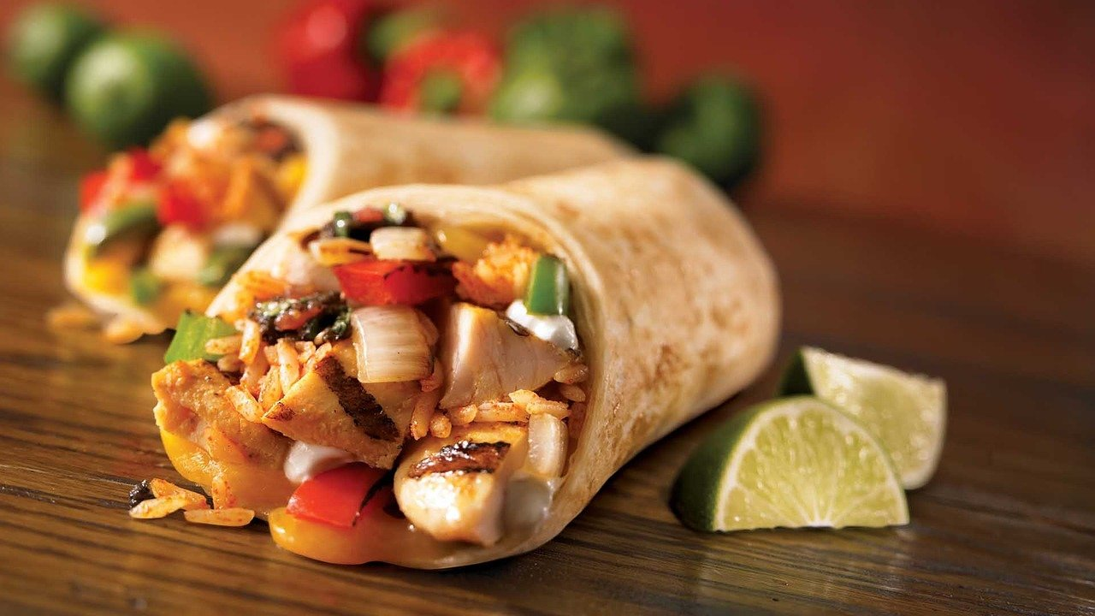
What Makes a Good Burrito?
Leveraging Machine Learning Methods to Predict Highly-Rated Burritos
By: Austin Jia
March 1, 2022

Slide 2

Motivation
My favorite way to relax after a long day is to enjoy a wonderful meal, but as a busy consultant, I don’t often get to be the one to cook those meals. Burritos are an amazing takeout food during those nights, but due to the complexity of the food, there is a wild degree of variation in quality across all the burritos I’ve tried. Sometimes the tortilla is amazing, but can’t make up for the dry steak inside. Sometimes the individual ingredients taste great, but the distribution of the ingredients within the burrito makes for inconsistent bites. What makes the perfect burrito? And perhaps more interestingly, what are some areas that businesses can invest in to quickly improve their burritos, which will in turn improve reviews and generate further business? With this dataset of almost 400 professional burrito reviews, I seek to understand which attributes of a burrito are most influential in driving our enjoyment of that burrito. Enjoy!

Slide 3

Exploratory Data Analysis
Data
Wrangling
Statistical
Modeling

Slide 4

Summary Statistics
385 Burritos
103 Restaurants
7 Months in 2016
$7.05 average cost
10 review attributes

Slide 5
Data Dictionary
Variable | Definition | Type | Response vs. Predictor
Overall Rating | Reviewer’s overall rating of burrito on 1-5 scale | Numeric | Response
Recommendation | Reviewer’s Y/N decision to recommend or not | Boolean | Response
Chips | Whether burrito came with chips | Boolean | Predictor
Cost | Price of burrito in dollars | Numeric | Predictor
Hunger | Reviewer’s hunger level on 1-5 scale at time of tasting | Numeric | Predictor
Volume | Volume of burrito in liters | Numeric | Predictor
Temperature | Reviewer’s rating of burrito temperature on 1-5 scale | Numeric | Predictor
Meat | Reviewer’s rating of burrito meat quality on 1-5 scale | Numeric | Predictor
Fillings | Reviewer’s rating of burrito fillings quality on 1-5 scale | Numeric | Predictor
Uniformity | Reviewer’s rating of uniformity of burrito ingredients on 1-5 scale | Numeric | Predictor
Wrap | Reviewer’s rating of burrito wrap quality on 1-5 scale | Numeric | Predictor

Slide 6
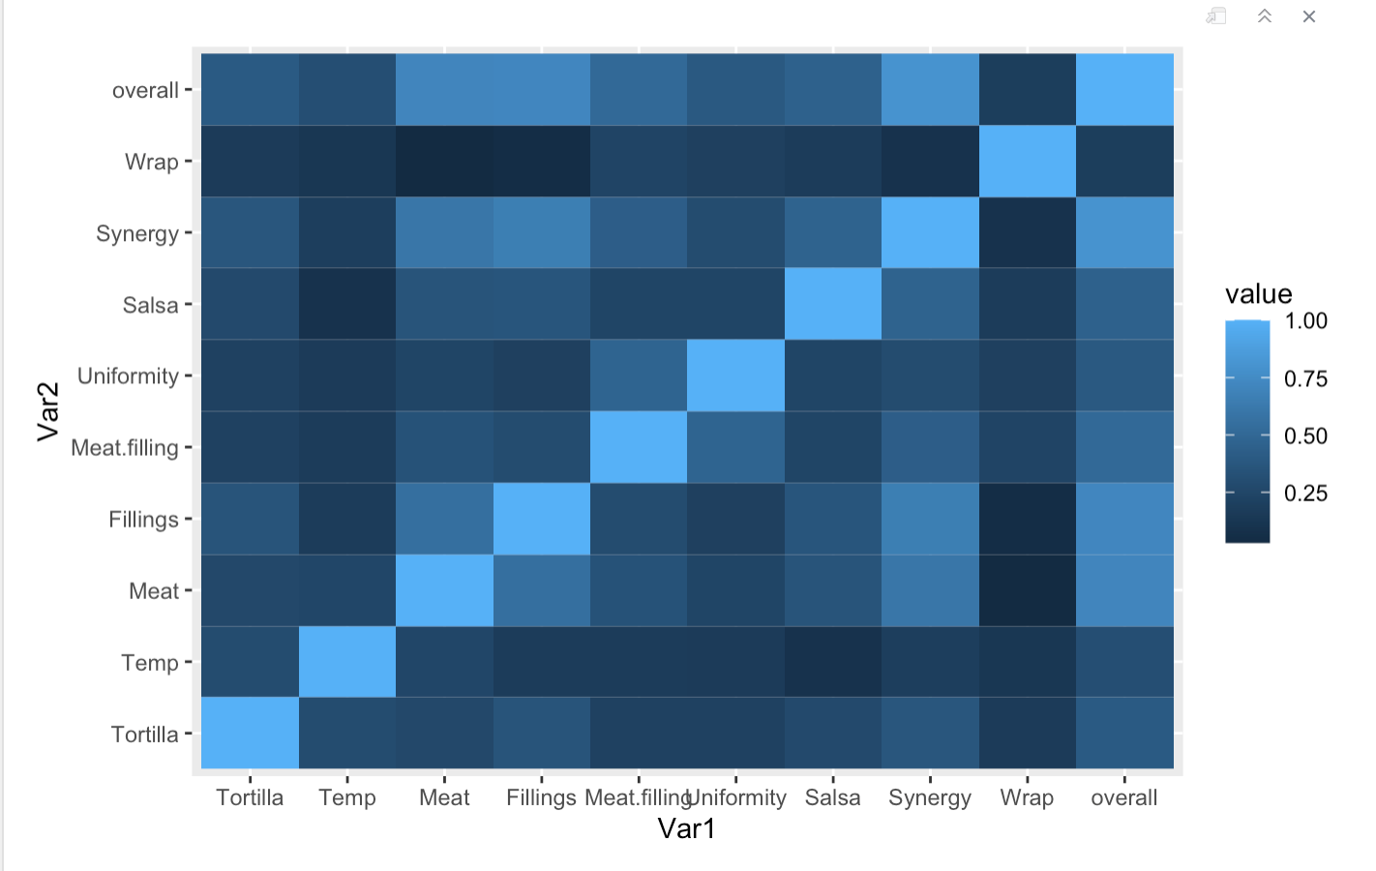

Exploring Collinearity
Synergy variable seems relatively highly correlated with several variables. We decide to remove the variable to address collinearity, and also because the variable is difficult to interpret
Figure 1: Correlation Matrix of Numerical Variables

Slide 7
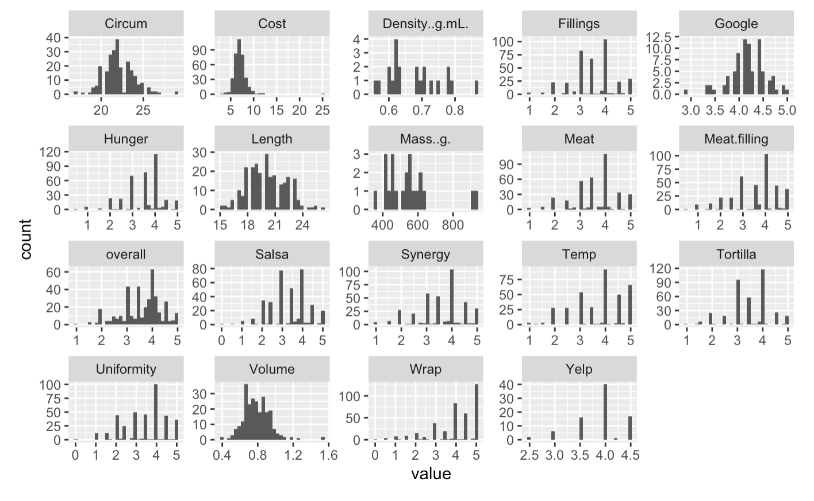
EDA of Quantitative Variables
Variables of interest appear relatively normally-distributed. Those that are not we remove from the model due to collinearity concerns. The value-add of logarithmic transformation is not worth the cost of lower interpretability, so we decide not to transform any variables.
Figure 2: Distribution Plots of Quantitative Variables

Slide 8
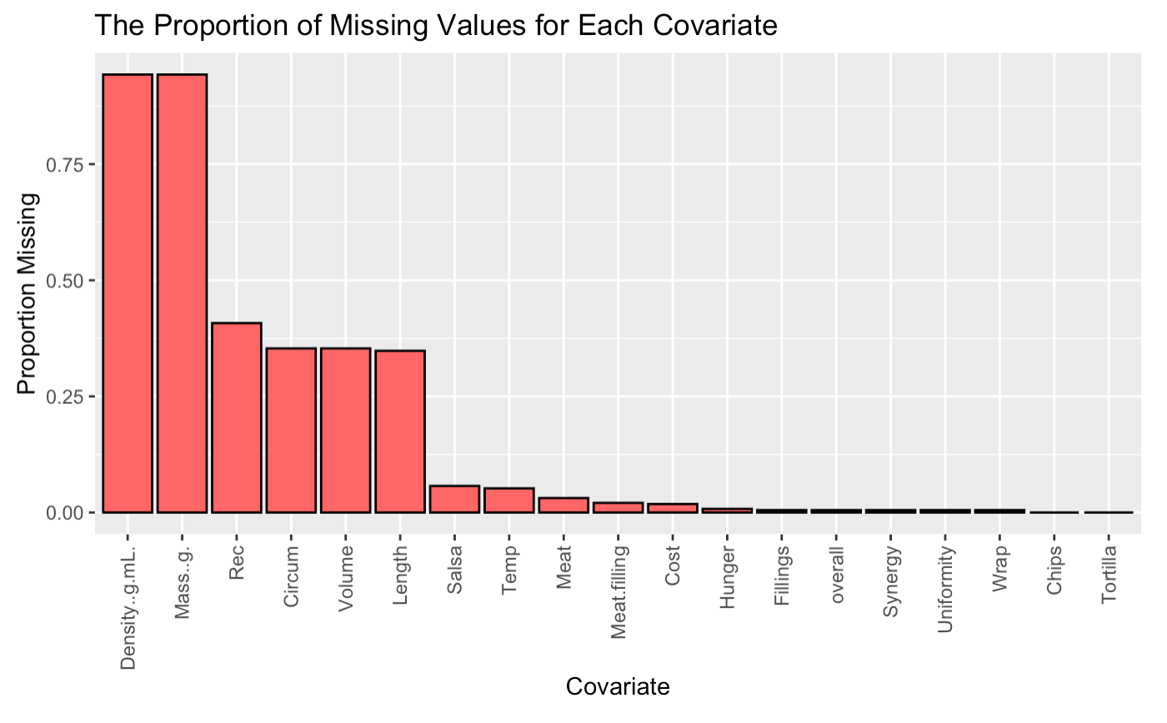
Data Missingness
18.7% of data values are missing, resulting in 0 complete cases
We decide to remove Density and Mass covariates as data missingness is too severe for imputation.
We decide to execute multiple imputation using chained equations, especially for the Rec variable, which is our classification response variable.
Figure 3: Data Missingness Plot

Slide 9
Exploratory Data Analysis
Data
Wrangling
Statistical
Modeling
Limitations

Slide 10
Dataset Wrangling
A
To solve for collinearity and data missingness concerns, the final model dataset includes 12 variables: Chips, Cost, Hunger, Volume, Wrap, Temp, Meat, Fillings, Uniformity, Salsa, Overall, and Rec.
B
We leverage basic regular expression to consolidate redundant data tags under one category (e.g. “Yes”, “Yes.” and “yes” all equal “Yes”.
C
Instead of dropping incomplete cases or depending on inaccurate mean imputation, we conduct Multiple Imputation using Chained Equations. Our final dataset features 100% complete cases.
D
We split the imputed dataset into an 80-20 train-test split to allow for model selection, resulting in 91 test values and 294 training values.

Slide 11
Data Wrangling
Statistical Modeling
Limitations
Exploratory Data Analysis

Slide 12
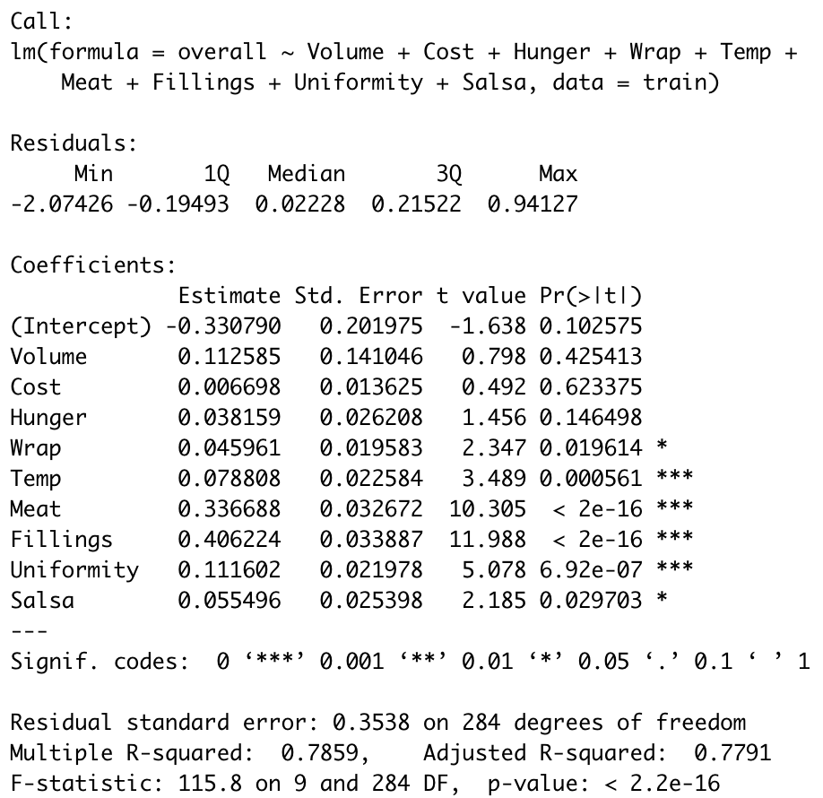
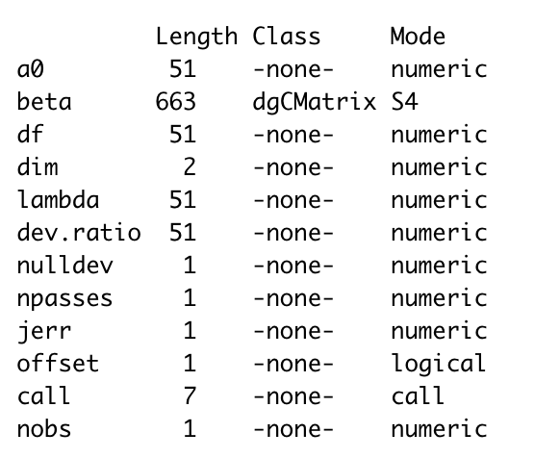
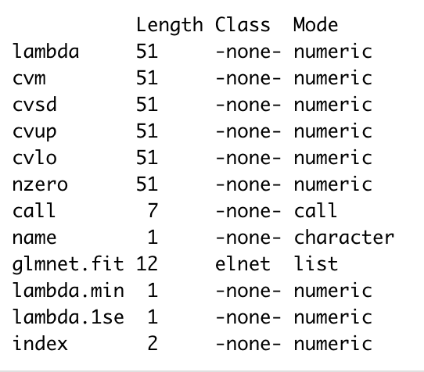
Overall Rating Model Selection
Response Variable: Overall Rating of Burrito given by reviewer
Prediction performance on test set
Multiple Linear Regression
R-Squared: 0.78
RMSE: 0.46
Ridge Regression
R-Squared: 0.68
RMSE: 0.44
Lasso Regression
R-Squared: 0.69
RMSE: 0.44
Multiple linear regression appears to perform the best, with drastically better R-squared, and equal test RMSEs. We move forward with the multiple linear regression model.
Figure 4: Multiple Linear Regression, Ridge Regression, and Lasso Regression Model Outputs

Slide 13
Overall Rating Model Interpretation
Variables that don’t matter:
Volume: It appears that the overall rating for reviewers is more driven by the quality of each bite rather than the number of bites
Cost: Cost variance is relatively small
Hunger: It appears that reviewers are too professional to allow their momentary dictate their ratings
Variables that do matter:
On average, all else constant, a 1 unit increase in…
Wrap Quality score results in a .05 unit increase in overall score
Temperature score results in a .08 unit increase in overall score
Meat score results in a .37 unit increase in overall score
Fillings score results in a .41 unit increase in overall score
Uniformity score results in a .11 unit increase in overall score
Salsa score results in a .06 unit increase in overall score
Figure 5: Multiple Regression

Slide 14
Recommendation Model Selection
Response Variable: Recommendation likelihood of the reviewer
Prediction performance on test set
Logistic Regression
75.8% classification accuracy on test set
Naïve Bayes
87.9% classification accuracy on test set
Random Forest
91% classification accuracy on test set
Support Vector Machine
90.1% classification accuracy on test set
Random forest performs best if we are prioritizing classification accuracy. We select the logistic regression for best interpretability.
Figure 6: Logistic Regression, Naïve Bayes, Random Forest, Support Vector Machine with Radial Kernel

Slide 15
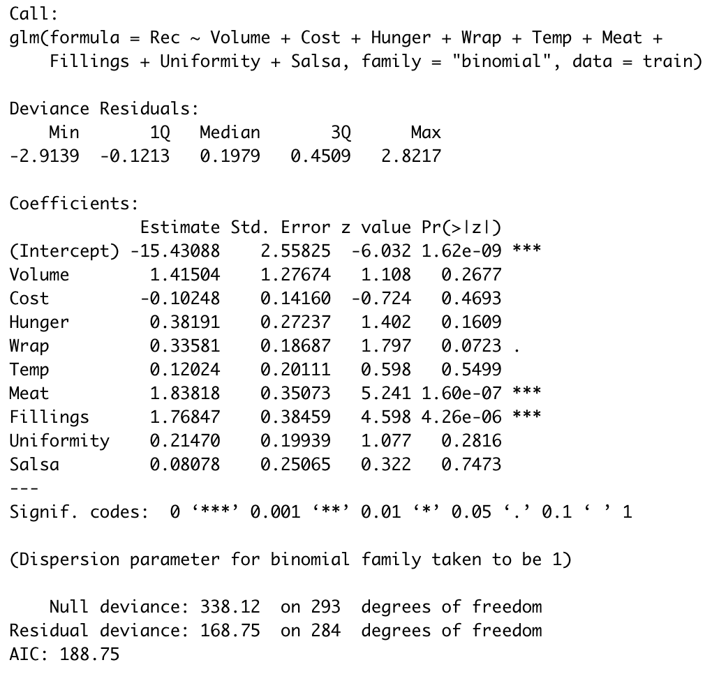
Recommendation Model Interpretation
Variables that don’t matter:
Volume, Cost, Hunger, Temperature, Uniformity, and Salsa
Variables that do matter:
On average, all else constant, a 1 standard deviation increase in…
Wrap score results in a 46% increase in probability of the particular burrito being recommended by the reviewer
Meat score results in 528% increase in probability of the particular burrito being recommended by the reviewer
Filings score results in 468% increase in probability of the particular burrito being recommended by the reviewer
Figure 7: Multiple Regression

Slide 16

Statistical Modeling
Limitations and Next Steps
Data
Wrangling

Slide 17
Next Steps
Limited sample size – with more samples we could have included the Boolean ingredients variables to “construct” the perfect burrito
”Recommendation” output variable had over 25% missingness, which may have introduced bias in MICE imputation
Obtain data over longer period of time and across more regions to better extrapolate model results

